Slide 1
First Performance Analysis of MAD-NG Embedded Tracing JIT Compiler
Aurelien Bloch
Supervisor: Laurent Deniau
EPFL supervisor: Martin Odersky
Master thesis, 11 September 2018

Slide 2
Outline
Introduction
LuaJIT
Object Model
Conclusion and future work

Slide 3
Outline
Introduction
LuaJIT
Object Model
Conclusion and future work

Slide 4
Methodical Accelerator Design
TODO

Slide 5
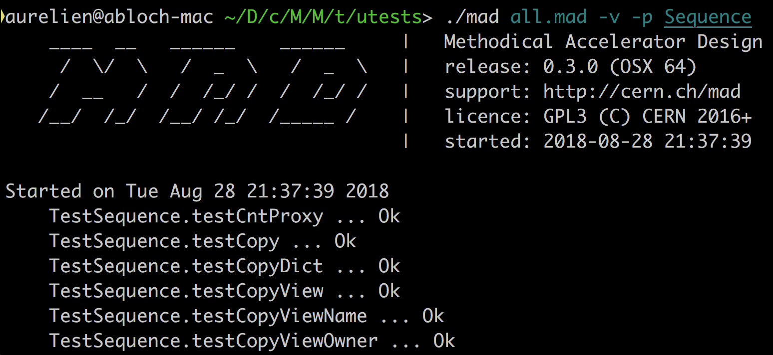
MAD Next Generation
TODO

Slide 6
MAD Next Generation
TODO
mad patch examples

Slide 7
MAD Next Generation
TODO

Slide 8
Lua programming language
TODO

Slide 9
LuaJIT Tracing JIT Compiler
TODO

Slide 10
Problem description
TODO

Slide 11
Project goals
TODO

Slide 12
Outline
Introduction
LuaJIT
Object Model
Conclusion and future work

Slide 13
LuaJIT
TODO

Slide 14
LuaJIT
Frontend

Slide 15
LuaJIT
Bytecode interpreter

Slide 16
LuaJIT
Library

Slide 17
LuaJIT
FFI

Slide 18
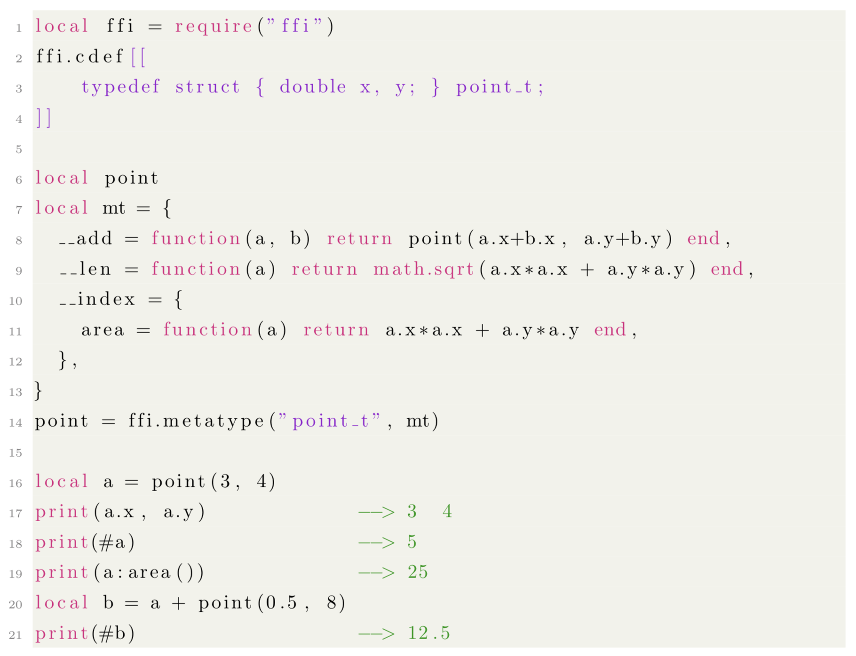
LuaJIT
FFI example 1

Slide 19
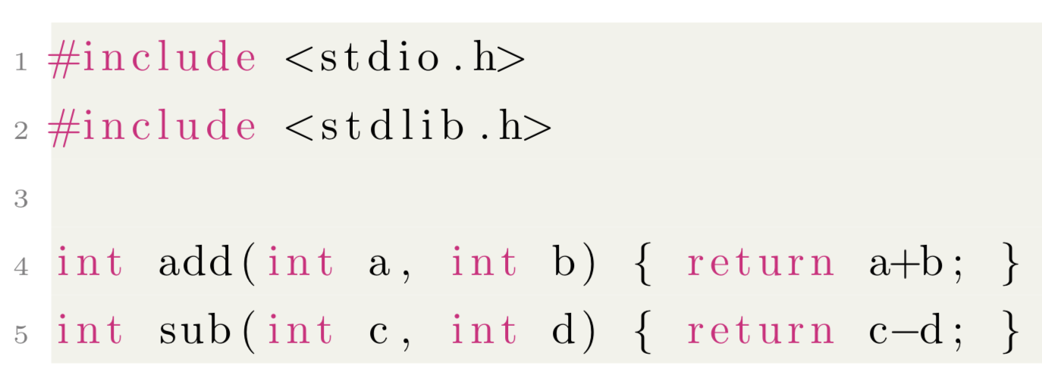
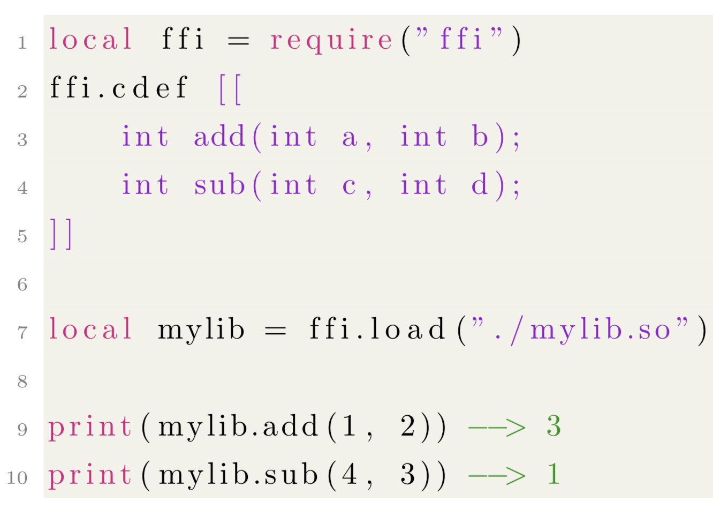
LuaJIT
FFI example 2

Slide 20
LuaJIT
JIT

Slide 21
LuaJIT
Trace recorder

Slide 22
LuaJIT
Trace optimizer

Slide 23
LuaJIT
Trace assembler

Slide 24
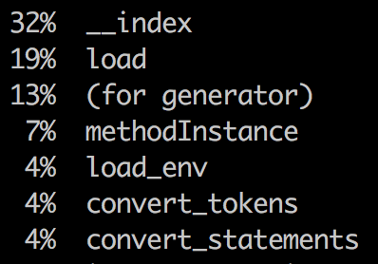
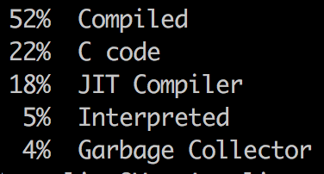
LuaJIT
Tool: profiler

Slide 25
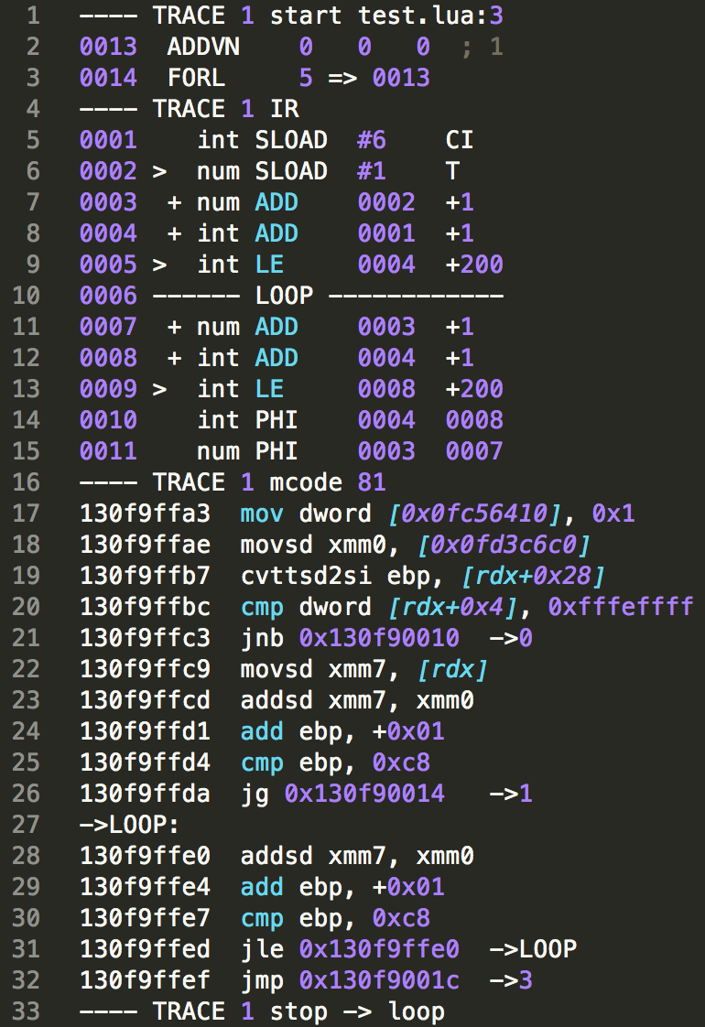
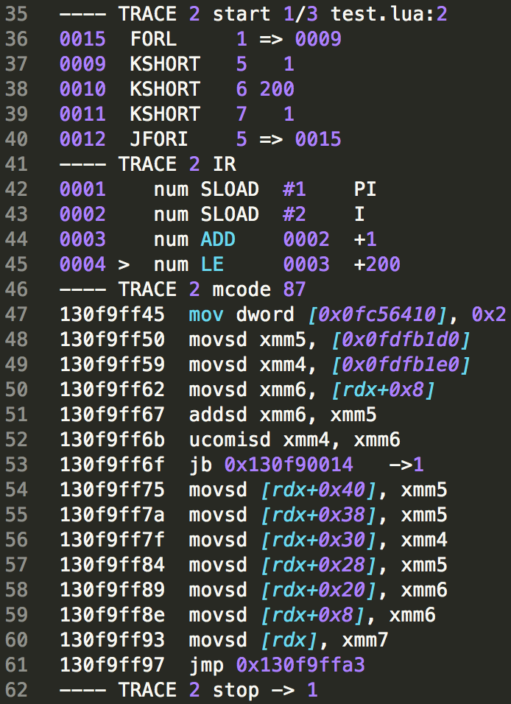
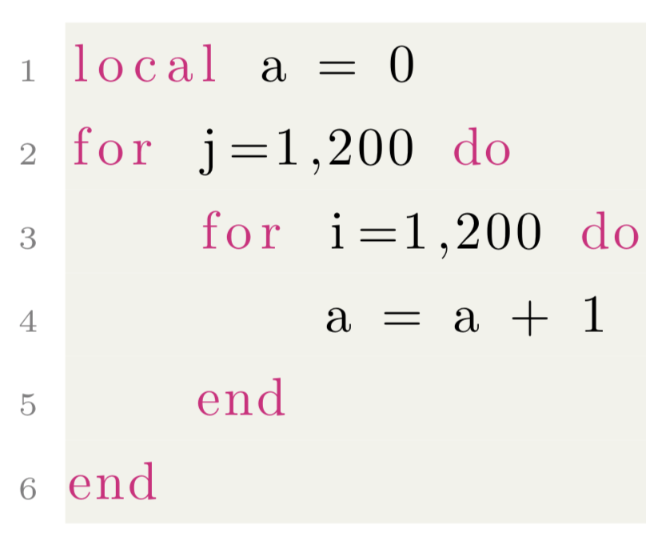
LuaJIT
Tool: dump

Slide 26
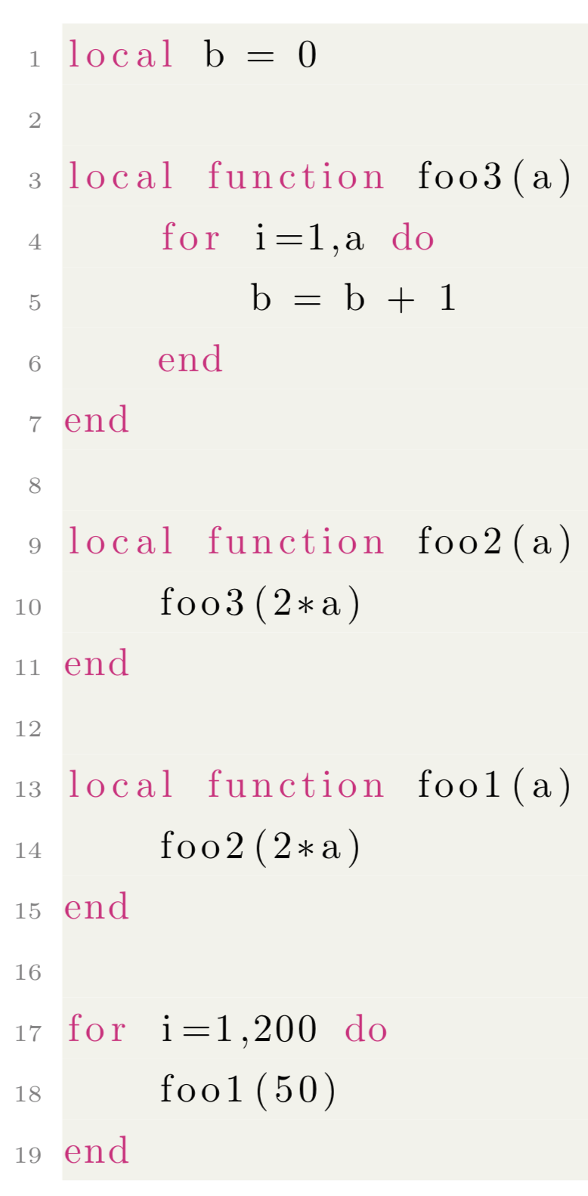
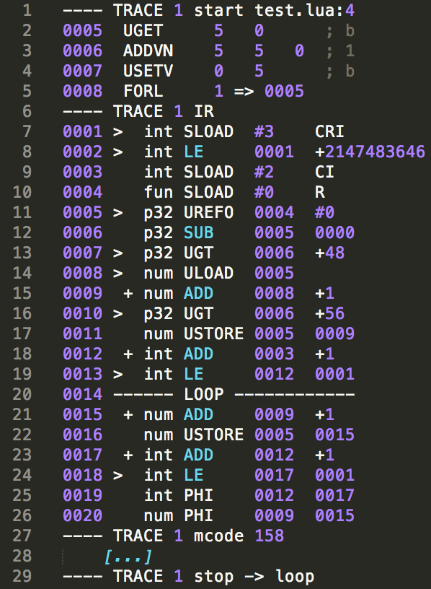
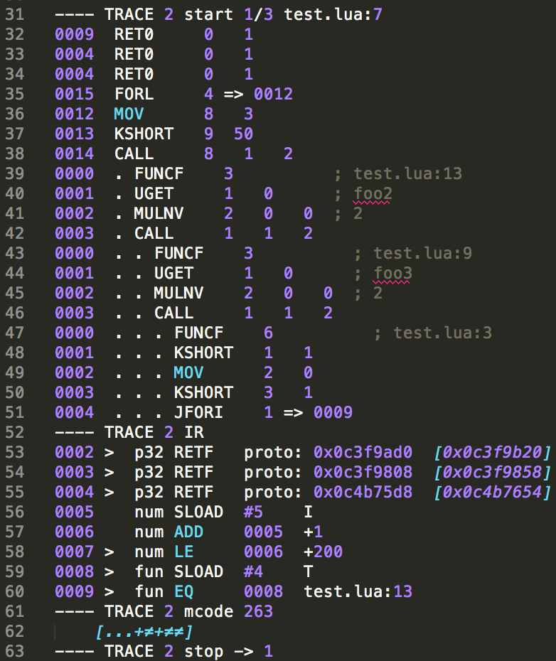
LuaJIT
Tool: dump

Slide 27
Outline
Introduction
LuaJIT
Object Model
Conclusion and future work

Slide 28
Object Model
TODO

Slide 29
Description
TODO

Slide 30
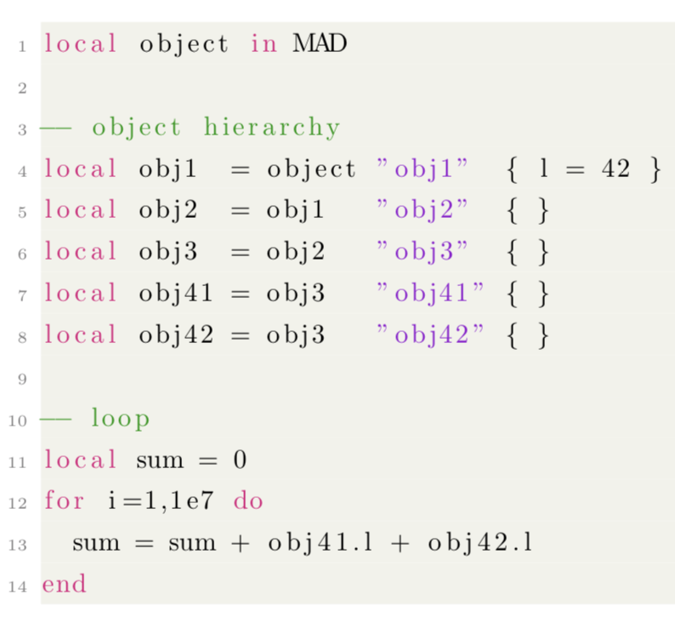
Performance analysis
Example 1
Obj1
l
Obj2
Obj3
Obj41
Obj42

Slide 31
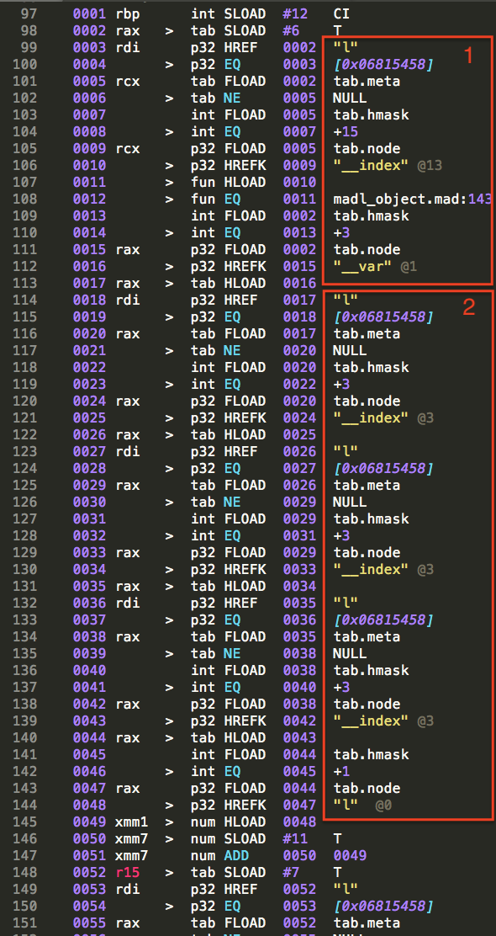
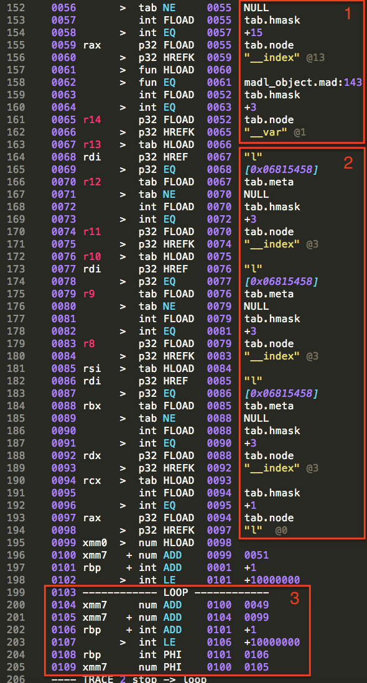
Performance analysis
Example 1

Slide 32
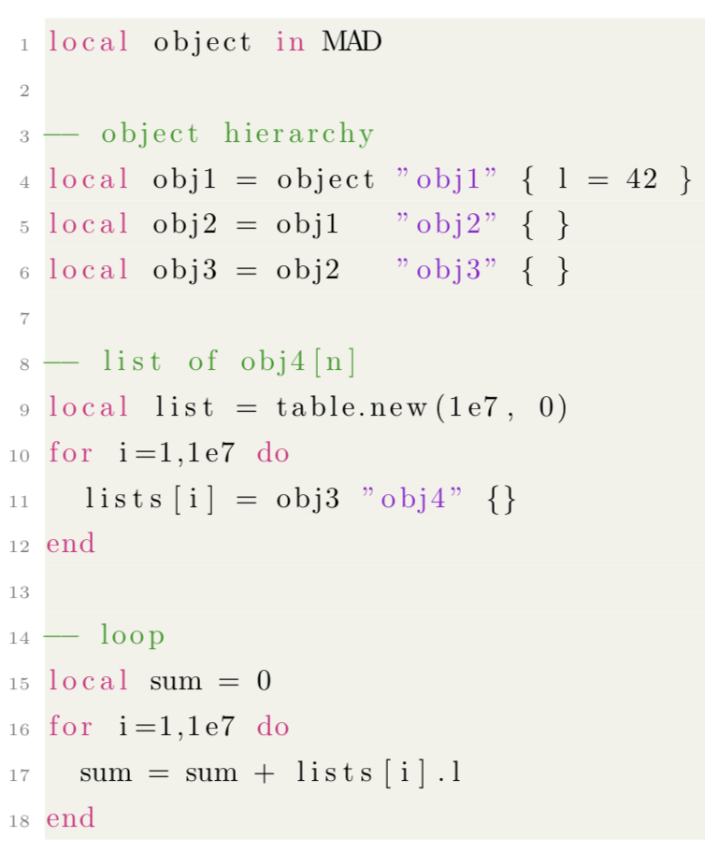
Performance analysis
Example 2
Obj1
l
Obj2
Obj3
List
Obj41
Obj42
Obj4[n]
[...]

Slide 33
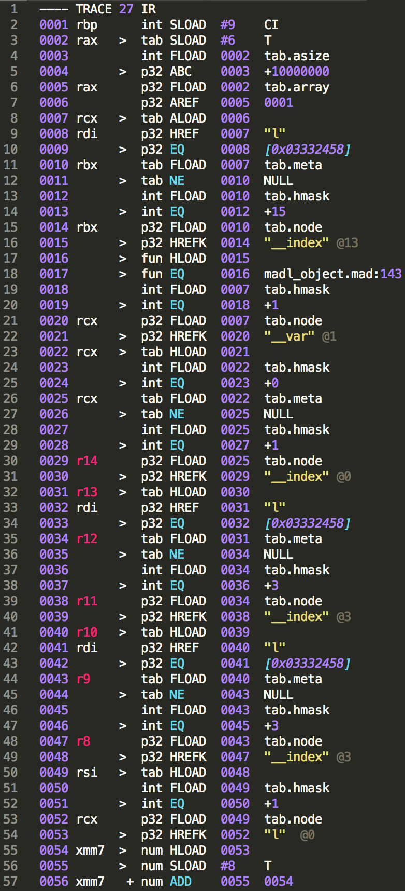
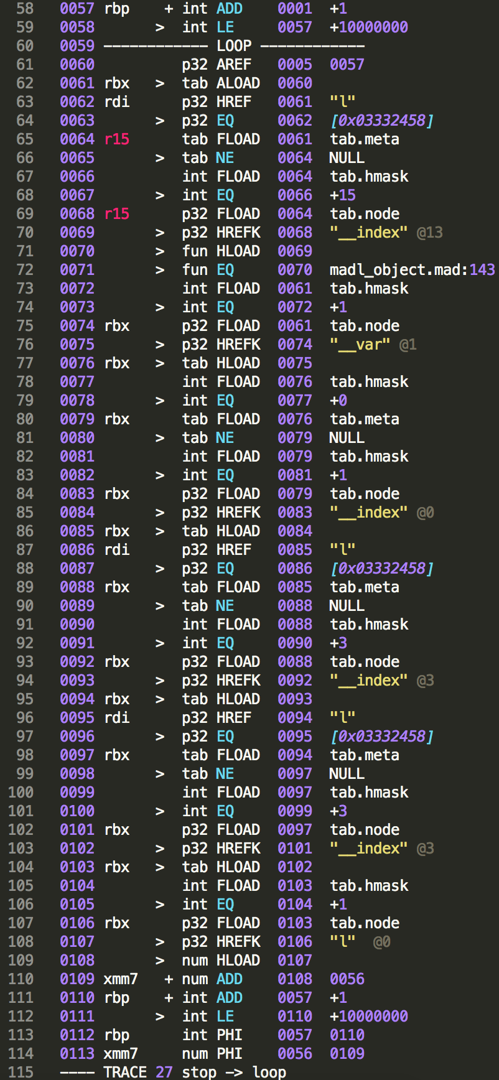
Performance analysis
Example 2

Slide 34
Possible explanations for performance hit
TODO

Slide 35
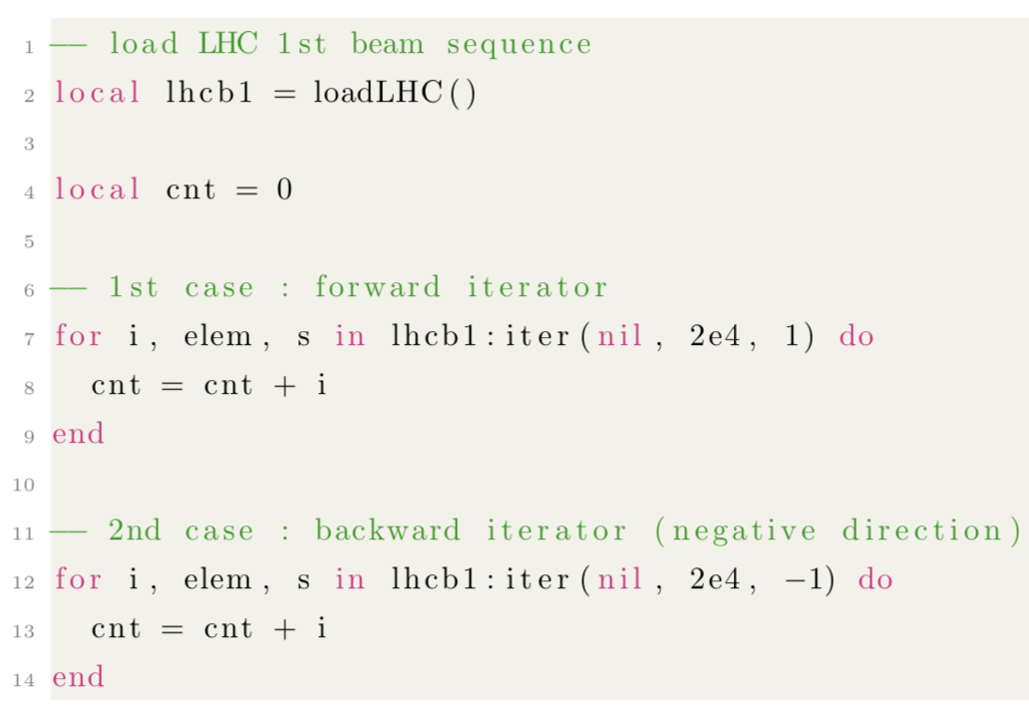
Sequence iterator
TODO

Slide 36
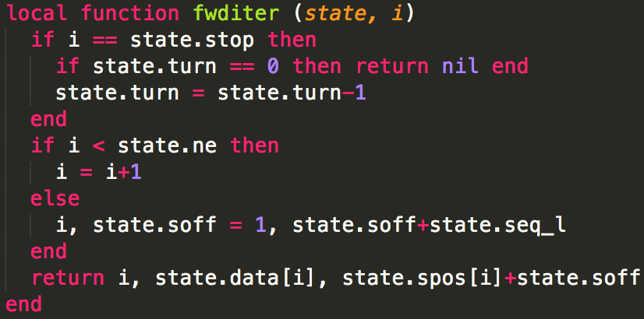
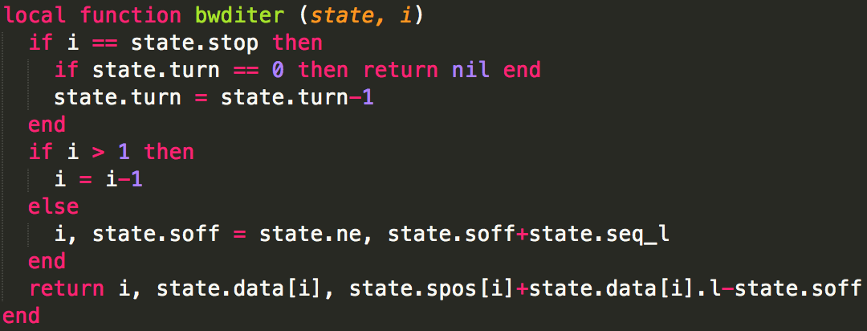
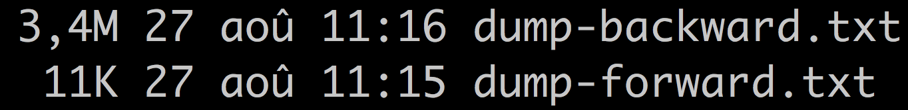
Sequence iterator
TODO

Slide 37
Alternative design
TODO

Slide 38
Outline
Introduction
LuaJIT
Object Model
Conclusion and future work

Slide 39
Conclusion and future work
TODO

